Slide 1


+
Dr. Charles R. Severance
https://www.youtube.com/watch?v=EUETy2wfHh8

Slide 2
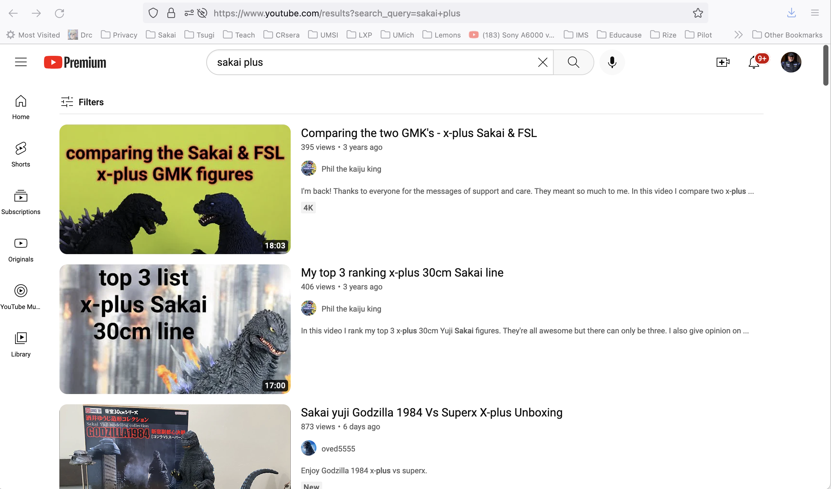

Slide 3
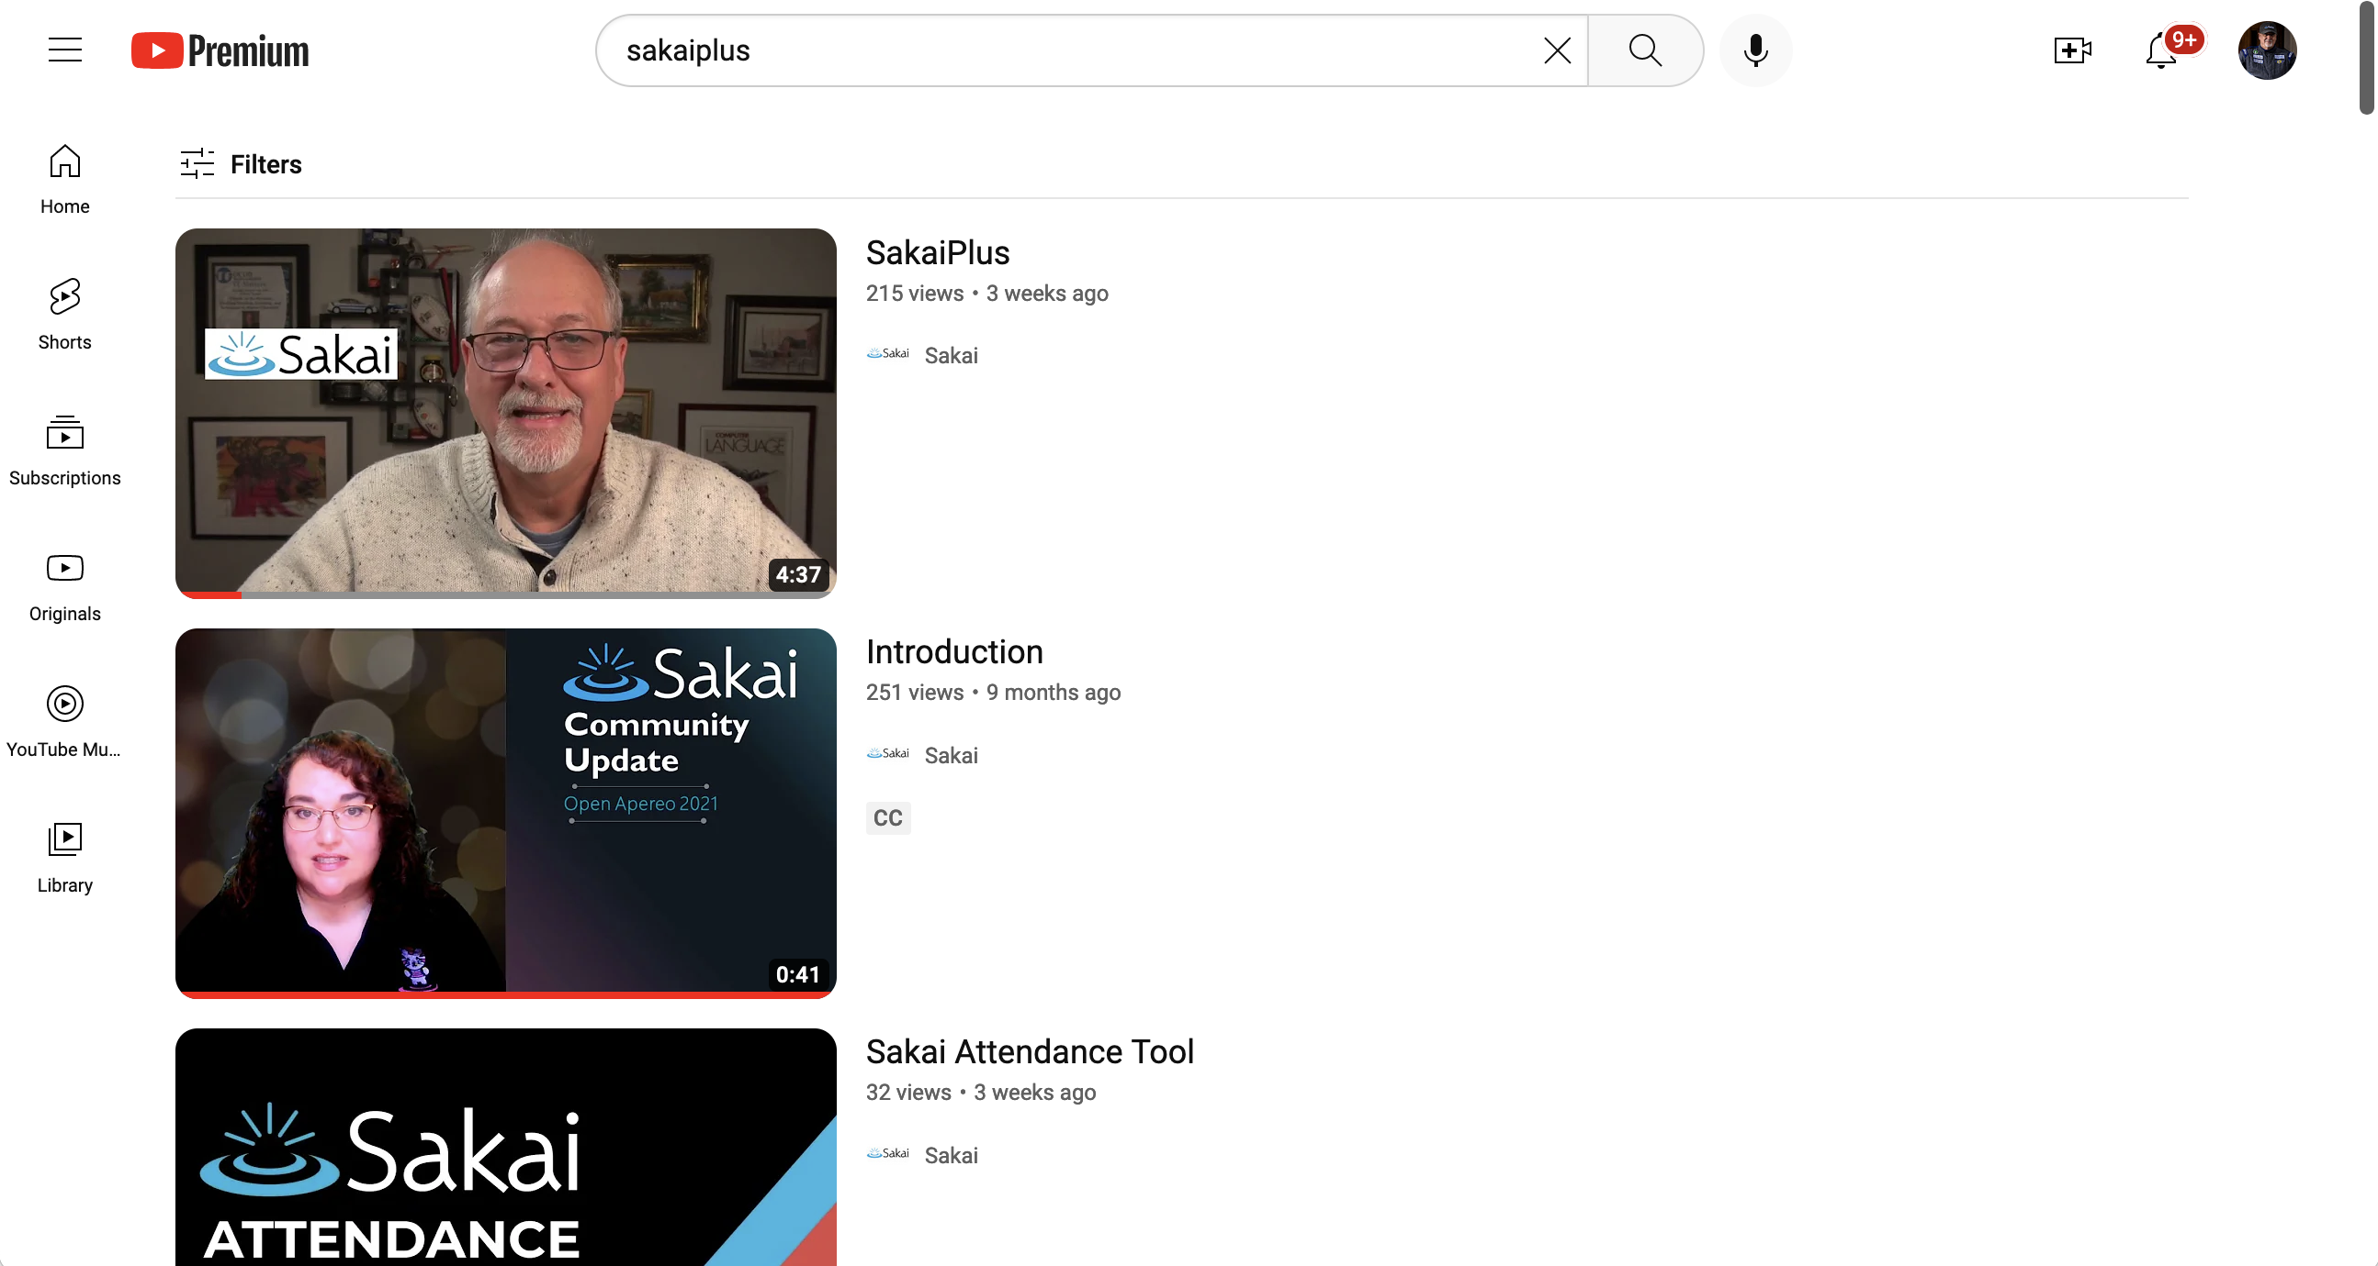

Slide 4


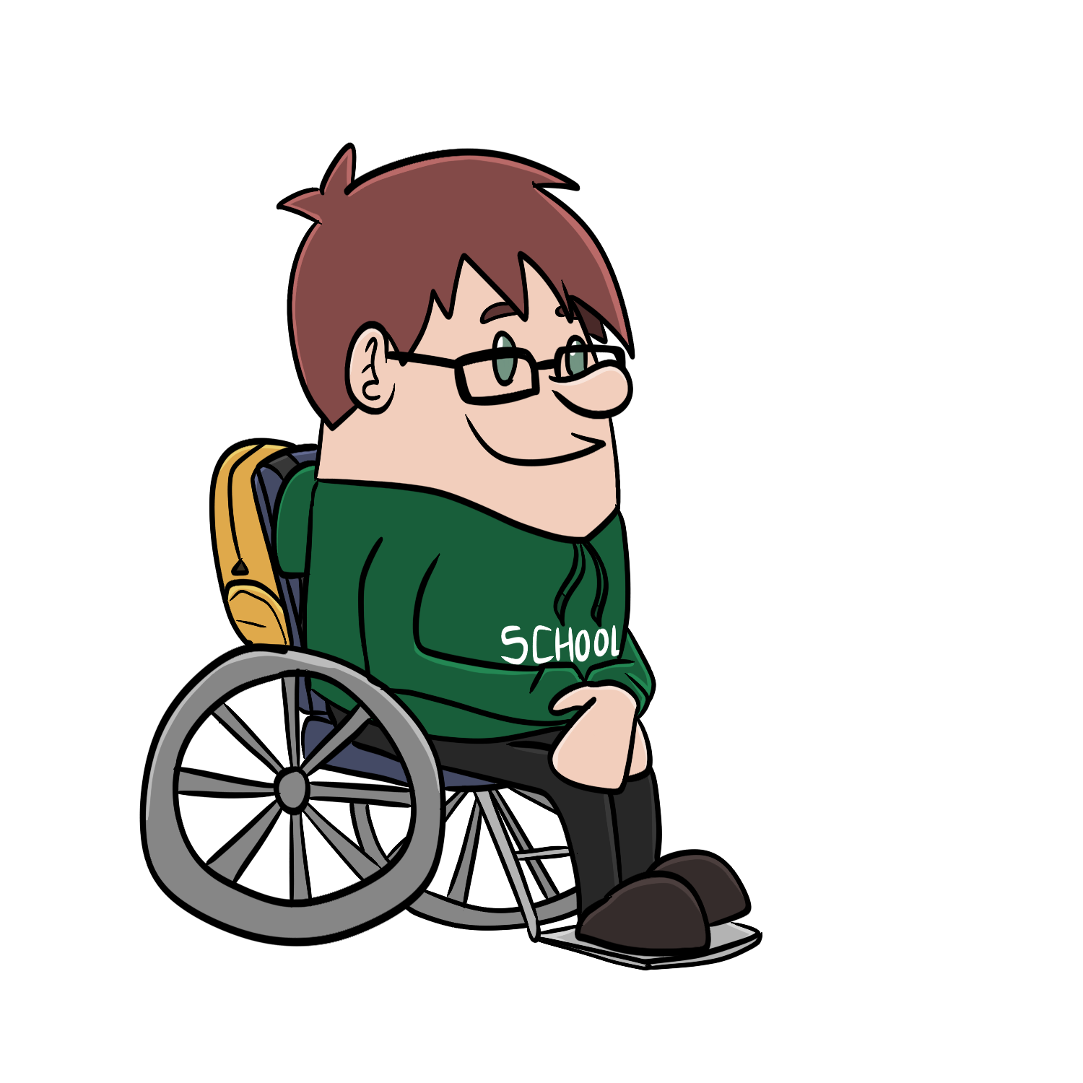




Campus
Information
System
Canvas
Blackboard
D2L
Moodle
Sakai
….
LTI Advantage
Synchronized grades
Synchronized roster

Slide 5
Big Picture
Sakai Plus makes Sakai an LTI Advantage "Provider"
LTI 1.3 Launch (Receiving)
Names and Roles (NRPS) to retrieve / sync rosters
Assignments and Grades (AGS) to create grade columns and sync scores
Deep Linking to install tool links in the content / modules / rich text editor in the LMS
Dynamic Registration for one-click installs
Canvas one-click JSON install (proprietary but important in the market)

Slide 6
Use Cases
Second "boutique" LMS
Sakai is the best LMS for Learning
Better learner privacy
Engaged community for active faculty
Some Sakai tools are well liked and not in other LMS systems
Samigo
Lessons
Roster
Mail Archive
Postem

Slide 7
Technical Ideas
We need a more "cloud-like" experience for IT staff
Easy deploy on AWS – working with AWS EdTech and AWS HigherEd
Released quarterly
Automatic upgrades
No forking!!!
Opportunities / Pricing
Free cloud for experiments provided by LearnXP
Small cloud provided instance
Run on amazon hardware under university control
On campus hardware / consortia hardware

Slide 8
If you want to play with / test Sakai+
It works on nightly
https://trunk-mysql.nightly.sakaiproject.org/portal/
Login as admin
https://github.com/sakaiproject/sakai/blob/master/plus/docs/TESTING.md
In 24 hours it resets again ☺

Slide 9
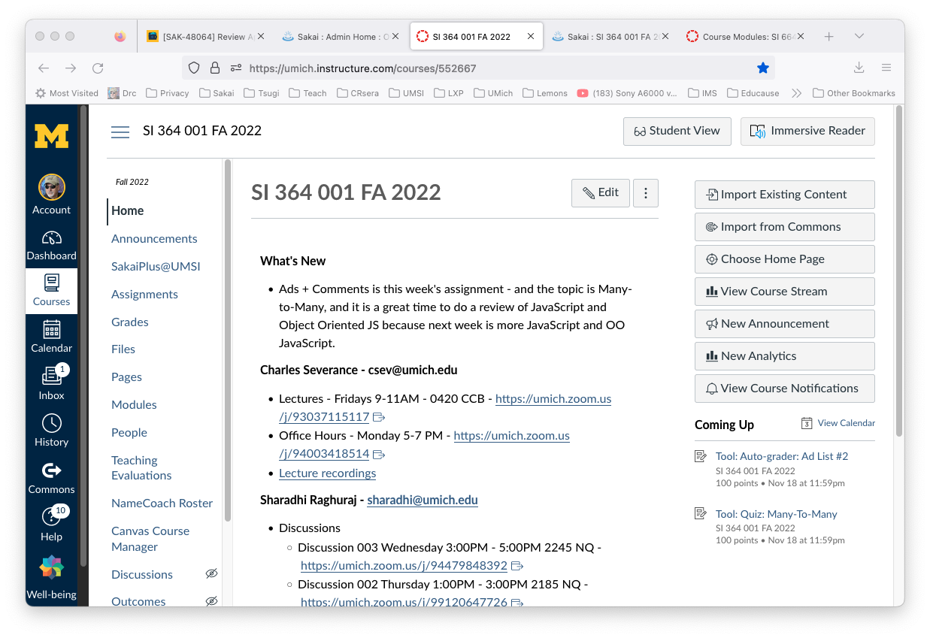

Slide 10
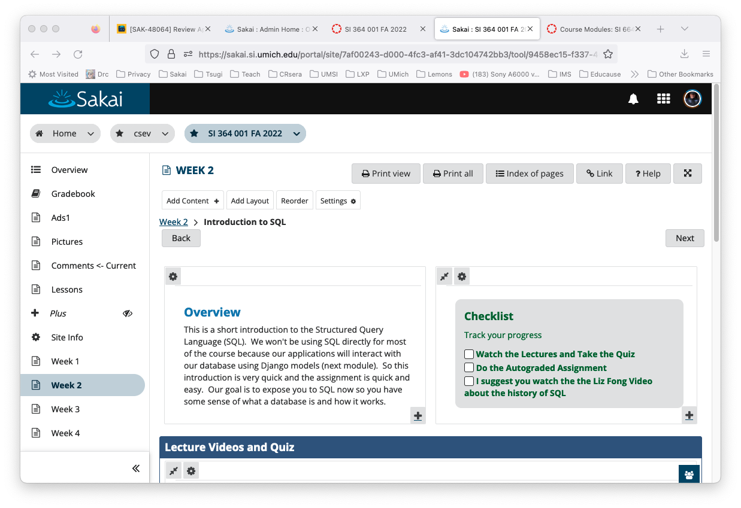

Slide 11
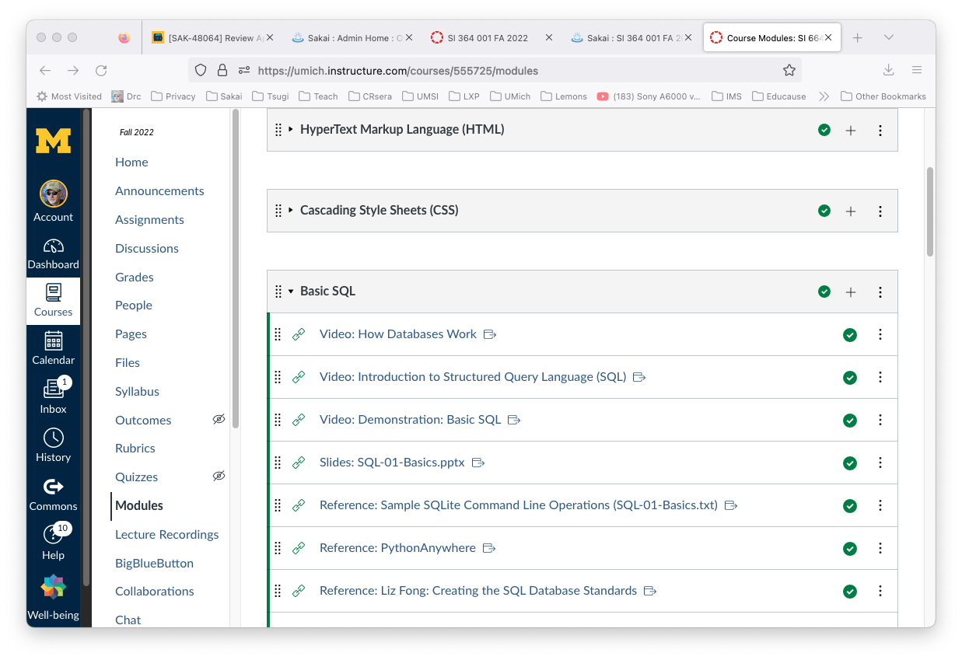

Slide 12
Next Steps
Talking to LMS vendors about partnerships
I might be invited to their conferences next summer to talk about Sakai+
Continue Beta test at University of Michigan
Looking for 3-5 Beta Customers
Interested in D2L, Canvas, Blackboard
Will be close coordination with me
Exploring business models – Sakai Sustainability
Traditional Cloud Provider (i.e. like many LongSight customers)
One premises support (Learning Experiences, Tom/Ron/Xerte)
Many “portals” are implementing LTI Advantage….

